Slide 1
Grammar #1 Continued
PUNCTUATION | semi-colons | colons| commas

Slide 2
SEMI-COLON

Slide 3
SEMI-COLONS ;
A semi-colon, the dot over a comma, separates two independent but related sentences. It is a linking device.
As we’ve learned, a semi-colon can fix a run-on.
INCORRECT: Whooping cranes are an endangered species; and they are unlikely to survive if we continue to pollute.
WHY is it INCORRECT?
The “and” is a coordinating conjunction that serves to link the first sentence to the second.
Therefore, the semi-colon is redundant.

Slide 4
How can the semi-colon issue be fixed?
INCORRECT: Whooping cranes are an endangered species; and they are unlikely to survive if we continue to pollute.
Remove the “and”→Whooping cranes are an endangered species; they are unlikely to survive if we continue to pollute.
Replace the semi-colon with a comma→Whooping cranes are an endangered species, and they are unlikely to survive if we continue to pollute.

Slide 5
Get worksheet
and go to Kahoot
for semi-colon practice!

Slide 6
Kahoot—correct sentences
The staff meeting has been postponed; therefore, I will be unable to get approval for my project.-CORRECT
5. You should always be prepared when you go camping; supplies like
sunscreen, food, water, and flashlights are essential.-CORRECT

Slide 7
Kahoot-possible corrections
2. Farm prices, especially related to dairy and cattle, have been falling steadily;
for the past two years.
For the past two years farm prices, especially related to dairy and cattle, have been falling steadily.
Farm prices have been falling steadily for the past two years; dairy and cattle products have been most affected.
3. Maria has taken karate for five years; but Lester has taken it for only one.
Maria has taken karate for five years, but Lester has taken it for only one.
Maria has taken karate for five years; Lester, however, has taken it for only
one.

Slide 8
Kahoot-possible corrections
4. Very few students signed up for the extra exam review session,
only the professor’s generosity kept it from being cancelled.
Very few students signed up for the extra exam review
session; only the professor’s generosity kept it from being
cancelled.
Very few students signed up for the extra exam review
session, but the professor’s generosity kept it from being
cancelled.

Slide 9
COLONS

Slide 10
COLONS :
The colon signals to the reader that information—a list, definition, explanation, concise summary—is about to follow. HINT: A full sentence usually precedes a colon.
CHECK:
once you put in a colon check what comes before it; is it a noun? Then you are probably correct to use the colon.
If it’s not a noun, ask yourself if any punctuation is really needed or if what comes after the colon interrupts the sentence (thereby requiring punctuation). Is a noun implied? See next slide for an example.

Slide 11
COLONS :
INCORRECT: Your instructions include the following steps, read the book, solve the equations, and check your answers.
Why is it incorrect?
A list of instructions comes after the word “follows,” so the colon, not the comma, should signal that to the reader. CHECK: “steps” is a noun
INCORRECT: Your instructions include the following, read the book, solve the equations, and check your answers.
Why is it incorrect?
A list of instructions comes after the word “follows,” so the colon, not the comma, should signal that to the reader. CHECK: the list interrupts the sentence’s fluency. Also, following “instructions” is implied.

Slide 12
How can the colon issue be fixed?
INCORRECT: Your instructions are as follows, read the book, solve the equations, and check your answers.
Change the comma to a colon→Your instructions are as follows: read the book, solve the equations, and check your answers.

Slide 13
PRACTICE: Number down on your scrap paper 1-5. Label each “C” for correct or “I” for incorrect. Talk through how to fix them.
I love summer activities: swimming, camping, surfing, and bicycling.
The chef’s signature dish includes: grilled chicken, pineapple, spices, and watermelon.
In order to write a good essay, you must: pre-write, draft, and revise.
I am sick and tired of your bad habits: leaving dirty clothes everywhere, piling dishes in the sink, and drinking straight from the milk carton.
This is what I want for lunch: a slice of pizza and a Pepsi.

Slide 14
Possible answers:
Delete any punctuation.
2. The chef’s signature dish includes all of the following ingredients:
grilled chicken, pineapple, spices, and watermelon.
Delete any punctuation
3. In order to write a good essay, you must complete these steps:
pre-write, draft, and revise.

Slide 15
Go to teacher page and click on link to practice online!

Slide 16
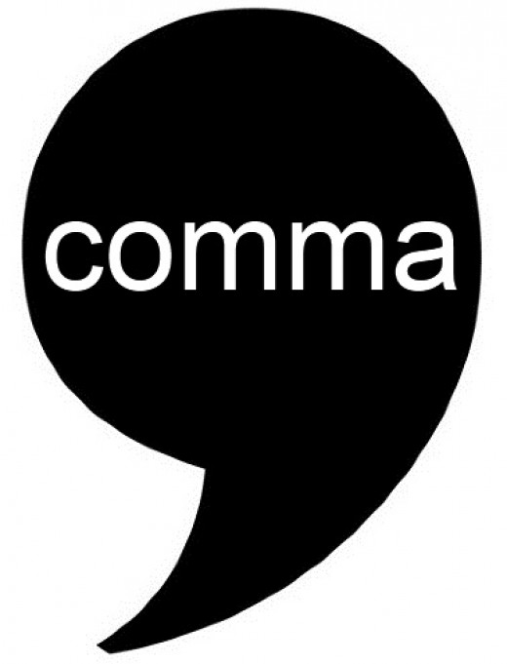
COMMAS

Slide 17
COMMAS ,
http://depts.dyc.edu/learningcenter/owl/comma_placement.htm
RULE: Place a comma after an introductory or transitional word.
Well, it is necessary to write a lot of papers in college courses.
Therefore, it is useful to know where to place the comma.
RULE: Place a comma after an introductory element—a clause or phrase that cannot exist as a sentence on its own.
Given that he was unprepared for the test, he did not perform well on it.
At the end of the movie, we realized who the murderer was.

Slide 18
RULE: Place a comma before a coordinating conjunction in a compound sentence (in other words, if the coordinating conjunction—and, or, but, for, yet, nor, so—joins two full sentences, put the comma before the conjunction).
He was late arriving to class, and the other students had already begun the test.
She went to bed early, so she would not be tired the next day.

Slide 19
RULE: Place a comma to set off an appositive, an explanatory phrase after a noun (it’s a noun phrase that adds extra description/ clarification).
Mrs. Smith, our next door neighbor, walks her dog every day.
The pharmacist at the drugstore, Mr. Jones plays tennis each day.

Slide 20
RULE: Use commas to separate items in a series.
Before I can buy prom tickets, I need to save money, pay my obligations, and serve that last detention hour.
RULE: Use commas to offset dialogue
“Well,” she said approvingly, “I guess you will be the smartest one in class.”
“I wonder if that’s right,” wondered the scientist as he examined his experiment data.
NOTE: Not everyone agrees about whether that comma should be there before “and” when commas link items in a series. It’s called the Oxford comma, and I like it. Use it! ☺

Slide 21
Practice: Go to the comma practice link on my teacher page (under the “writing and language section” tab).
http://www.bristol.ac.uk/arts/exercises/grammar/grammar_tutorial/page_45.htm

